Slide 1

Miniature Greenhouse Innovation
Peyton Lettau | Sebastian Hondl
John Robinson | Will McConnell
Notes:
Morning everyone. Today I'm presenting our work on designing a mechanism for miniature tabletop greenhouses. This project addresses a real engineering challenge: how do we scale greenhouse technology from full-size applications down to desktop scale? Our solution seeks to uses a six-bar linkage mechanism to provide controlled access to plants while maintaining the functionality of larger greenhouse systems.

Slide 2

Greenhouse Primary Functions
Temperature Control
Short-wave light transmission
Moisture/Humidity Control
Notes:
Let's start with the basics. A greenhouse works by creating a controlled microclimate - it lets in sunlight for photosynthesis while trapping heat and moisture to create an ideal growing environment. The key requirements are high light transmission, thermal retention, moisture control, and balanced ventilation.
But here's the problem: the mechanisms that work great at full scale don't work when you try to scale them down. This is where our project comes in - we need to design new mechanisms specifically for small-scale applications."

Slide 3
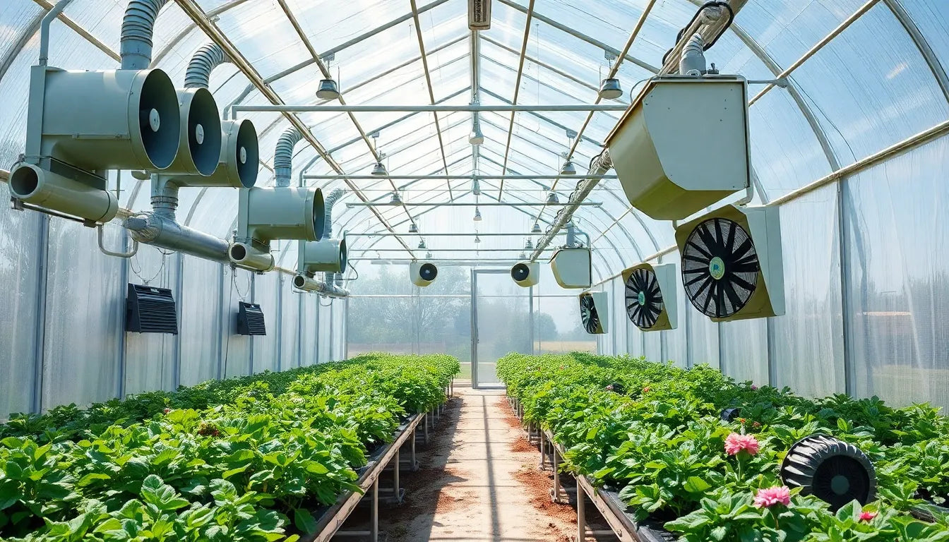
Notes:
Large industrial applications use huge canopies, fans, sensors, heaters, and other cumbersome technology to manager their growing environments.
Now, when we scale this down to desktop size, we face a fundamental challenge: the same principles apply, but we're working in a much more compressed space with new constraints. Now the issues of access, cost, and plant growth conditions are more challenging.
This is where our project comes in - we need to design a new mechanism specifically for small-scale applications.

Slide 4
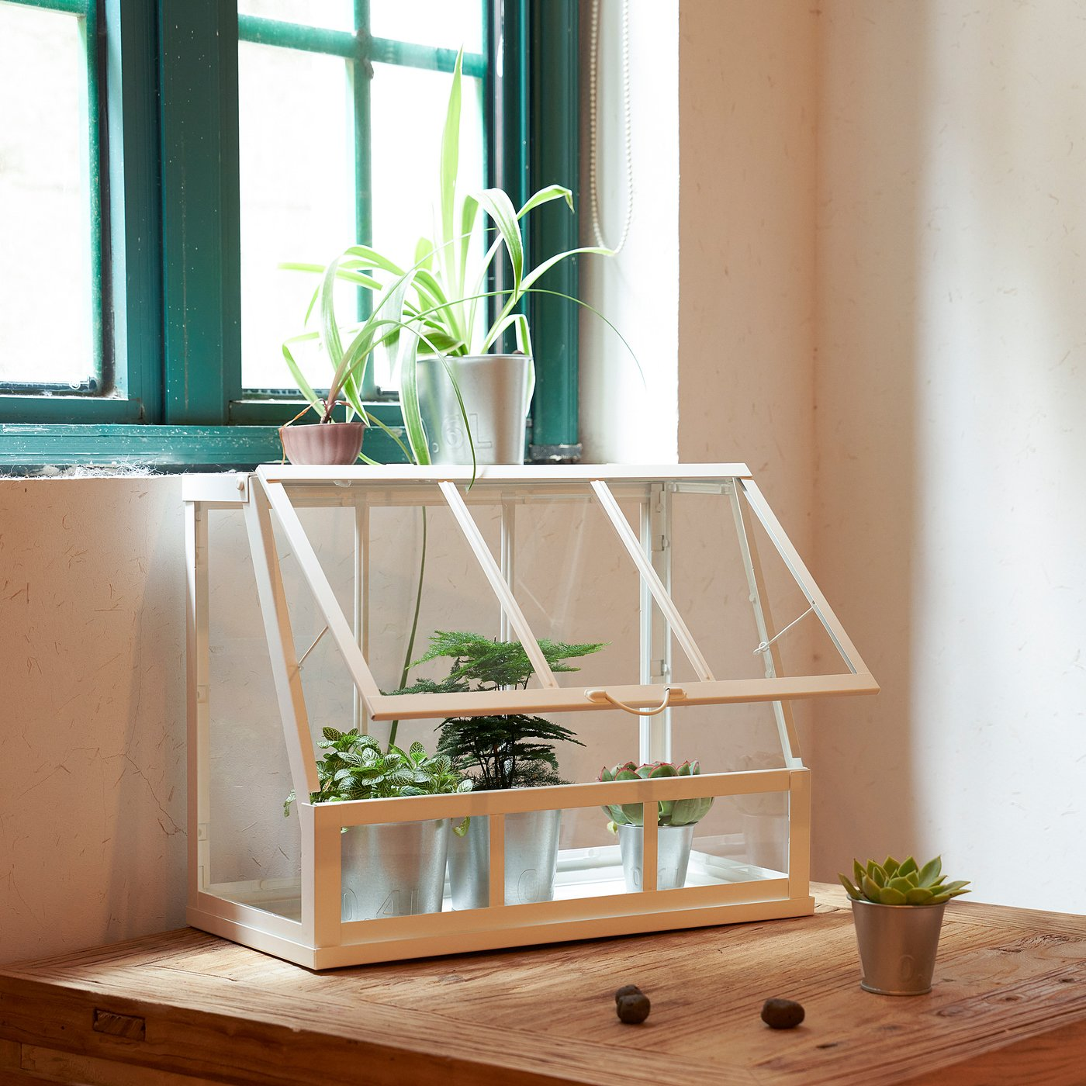
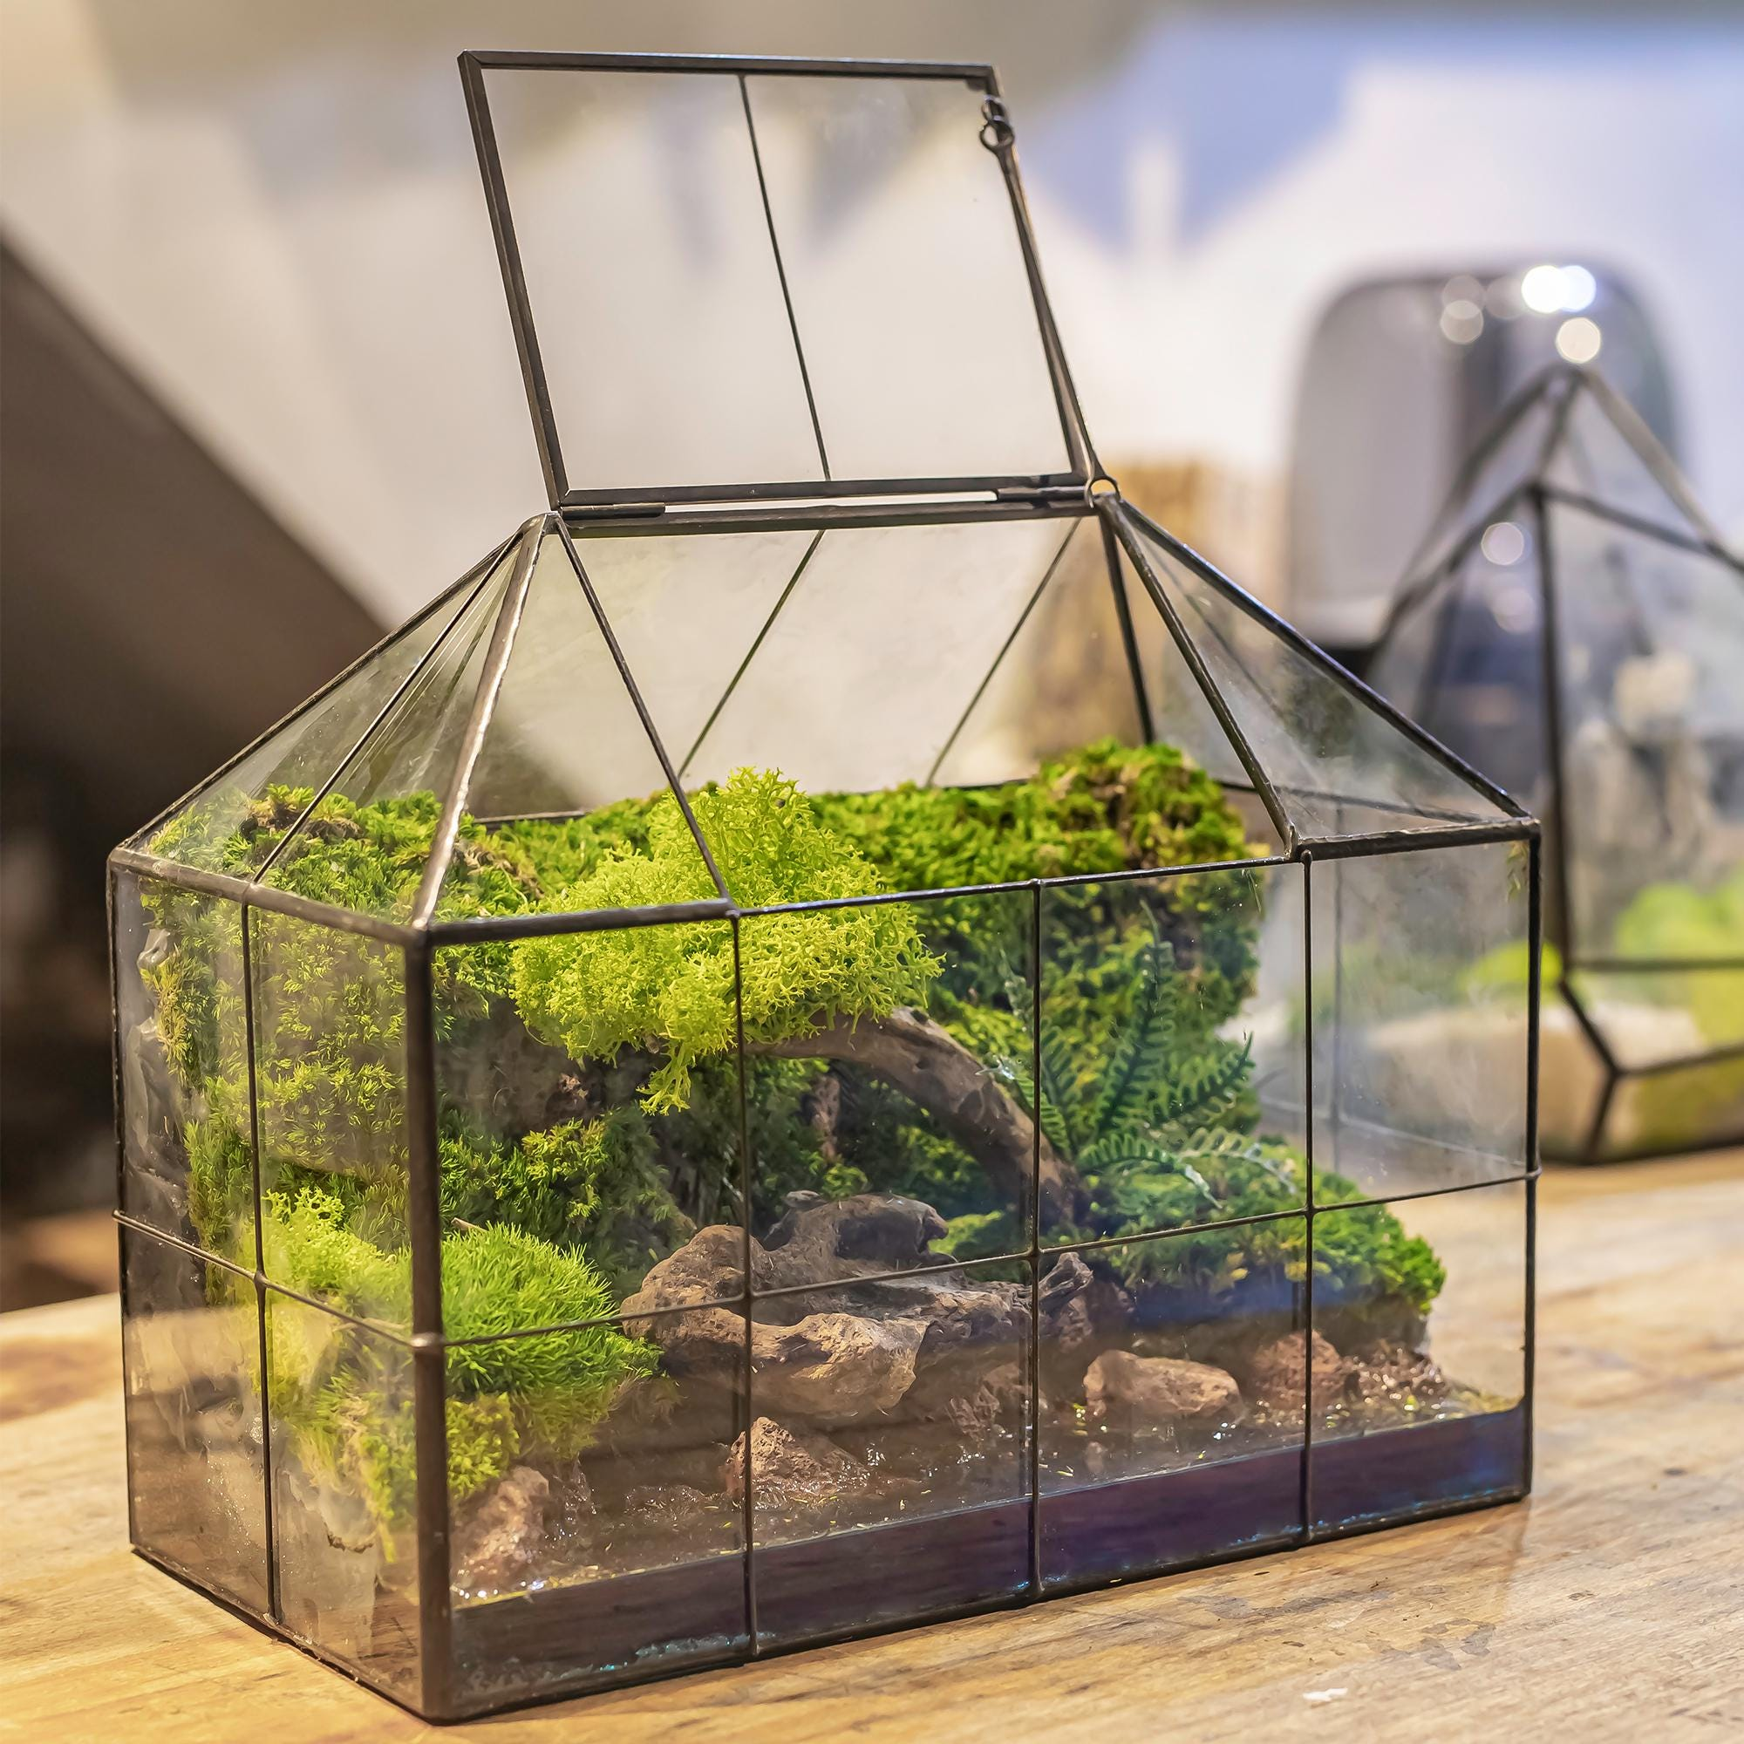
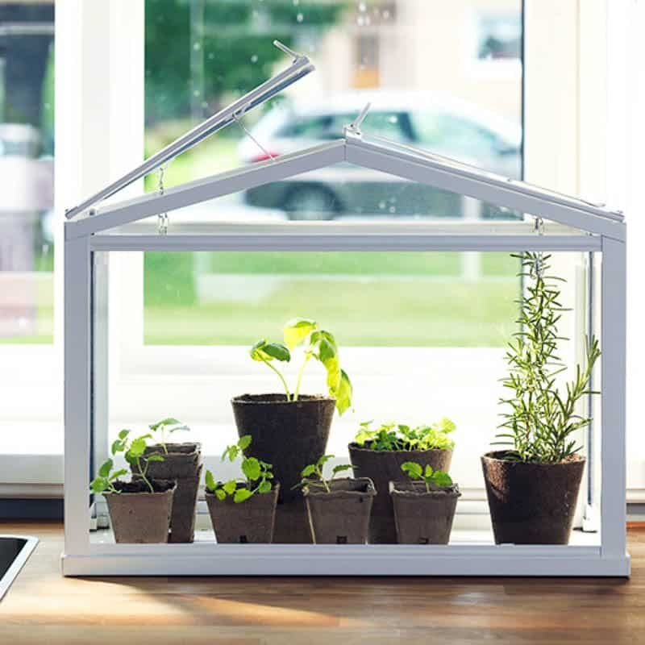
Notes:
Previous examples of desktop greenhouses range in size and design. this one uses a larger wooden construction with a simple hinge for access, which can also be propped open for ventilation. This one has a small hatch at the top for access, without any intermediate point for ventilation, and the one below has a roof hatch that can be angled for ventilation or removed for access.
several issues are consistent among these examples. the ease of access to all sides of the plants and adjustability of ventilation is simply not enough. Our design aims to solve these problems.

Slide 5
Goal Statement
Design and build a compact mechanism that opens and closes a tabletop greenhouse whose sides are constrained by adjacent walls. The mechanism shall articulate the top and front panels to provide full, unobstructed plant access and offer stable, adjustable hold-positions along the motion path for customizable ventilation.
Notes:
To do that, we’ve chosen this goals statement:
Design and build a compact mechanism that opens and closes a tabletop greenhouse whose sides are constrained by adjacent walls. The mechanism shall articulate the top and front panels to provide full, unobstructed plant access and offer stable, adjustable hold-positions along the motion path for customizable ventilation.
Now what does that look like…

Slide 6
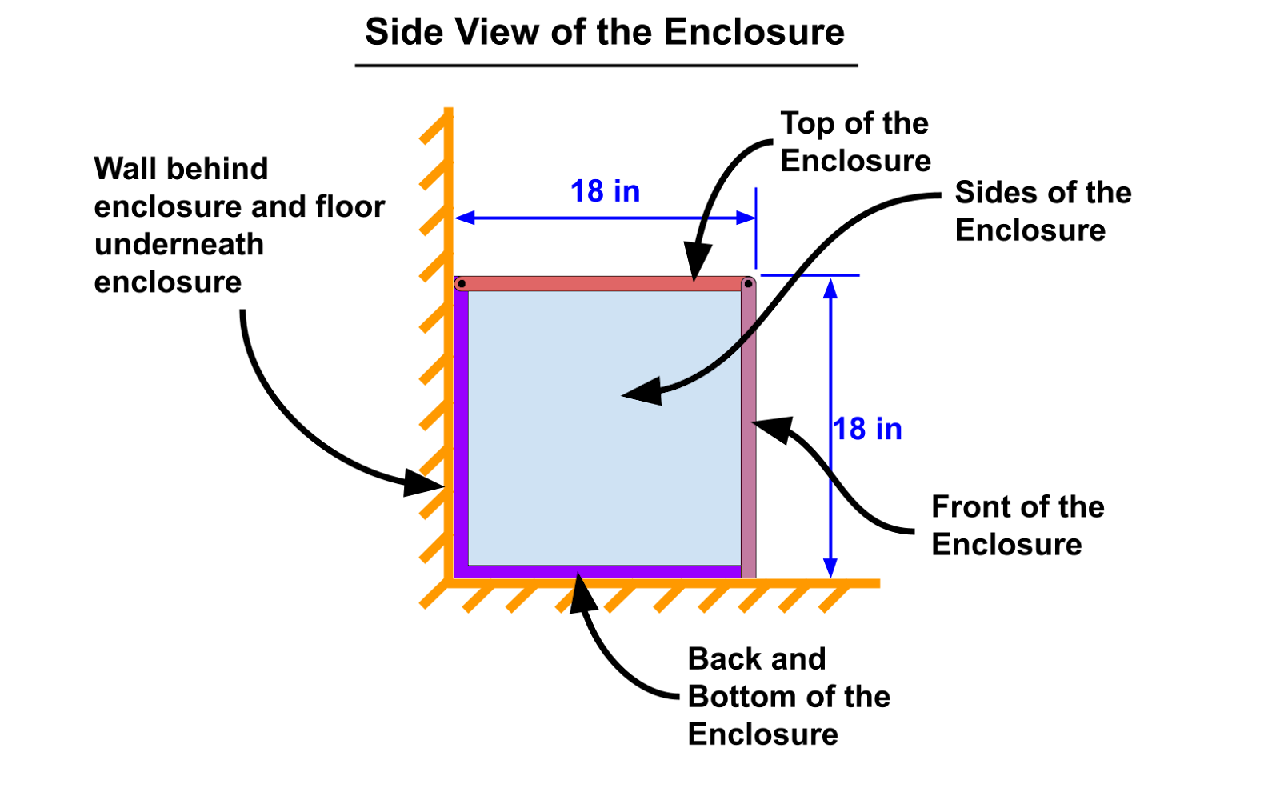
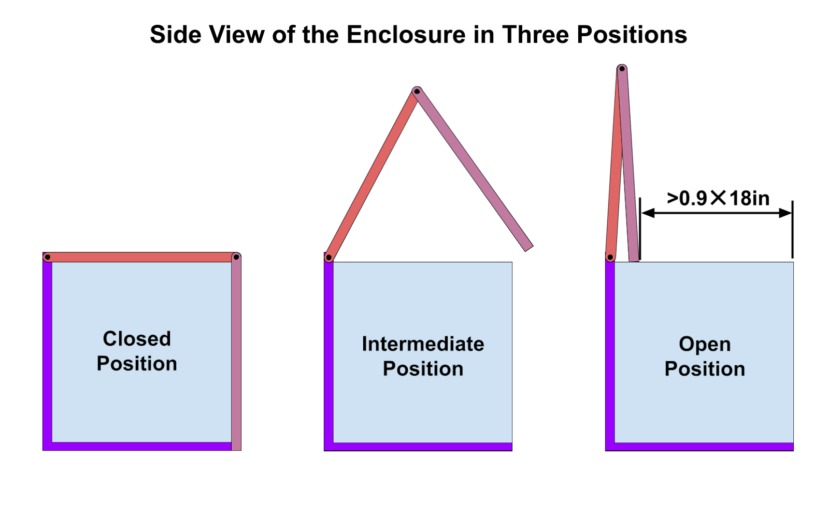
Notes:
Heres a quick mock up of the basic principles. As I the goal statement requires; there is a wall behind the enclosure. these graphics on the right show an example of our fully open and closed positions, as well as an intermediate position that we may choose for ventilation.

Slide 7
Project Specifications
Provide smooth, controlled motion for fragile glass panels (1/8” thick)
Enable access to plants from both top and front faces simultaneously
Operate within compact tabletop dimensions (approximately 18” tall × 18”deep × 24” wide)
Incorporate spring balancing to reduce actuation forces and prevent impact damage
The opening above the enclosure must be >90% of the depth of the enclosure
Mechanism must not extend beyond the greenhouse silhouette when closed
Compatible with placement against a wall
Minimize interference with internal plant growth space
Allow front and top of the enclosure to be positioned at any position between open and close and remain in place
Fold the top and front panels above the enclosure, creating unobstructed access for plant maintenance
Optimize linkage geometry to provide smooth velocity profiles while maintaining mechanical advantage throughout the operating range
Support the weight of the front and top of the enclosure ( ~ 5lb each)
Notes:
Here’s a detail list of our project specifications. The ones most important to today are:
enable access to plants from both top and front faces simultaneously
The opening above the enclosure must be 90% of the depth of the enclosure
The mechanism must not extend beyond the greenhouse silhouette when closed
must be compatible with placement against a wall
and minimize the interference with internal plant growth space

Slide 8
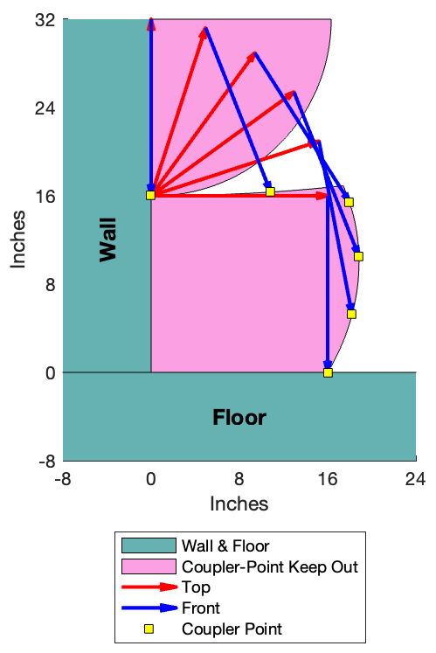
Notes:
For this mechanism, we chose to use motion generation of a coupler point along the front face to control the opening motion.
To understand our limitations, we created this model which shows the regions where our coupler point, assumed to be at the end of the front face, is allowed to be to meet our criteria.

Slide 9
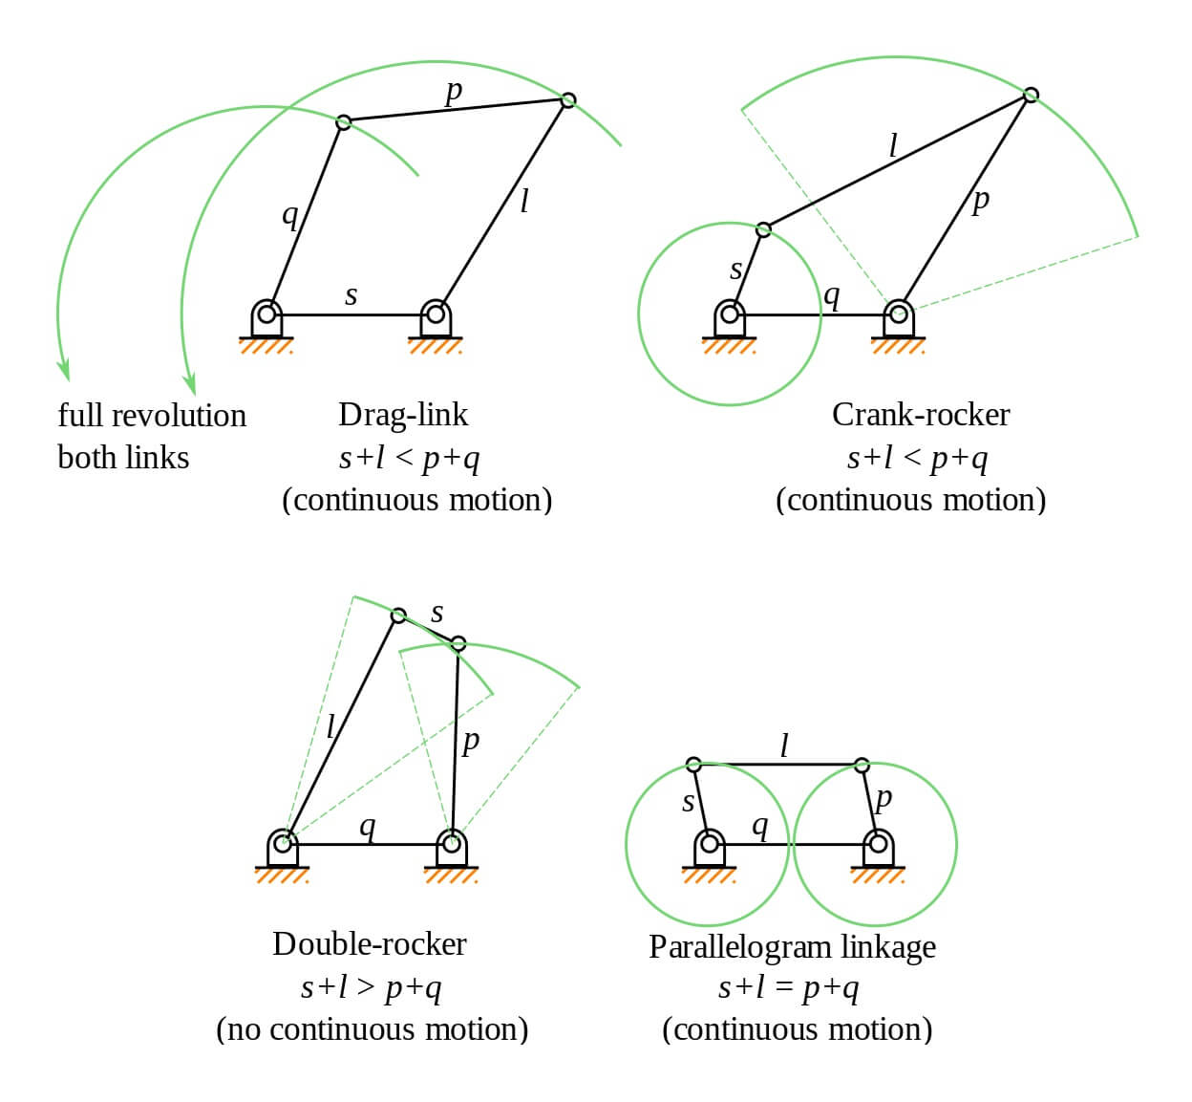
Type Synthesis - 4 Bar
Notes:
We then quickly evaluated the grashof 4 bar mechanisms for solutions, but quickly found that there was no suitable solution that could meet our complex motion requirements.

Slide 10
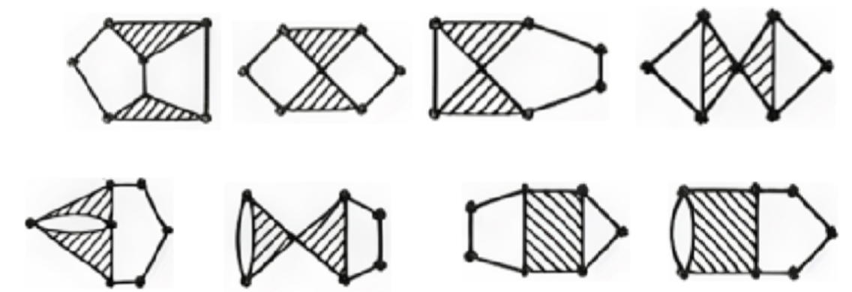
Type Synthesis - 6 Bar
Notes:
We then started evaluated 6 bar linkages. based on our desired degrees of freedom being 1, we narrowed our search to Stevenson and watt chains.

Slide 11
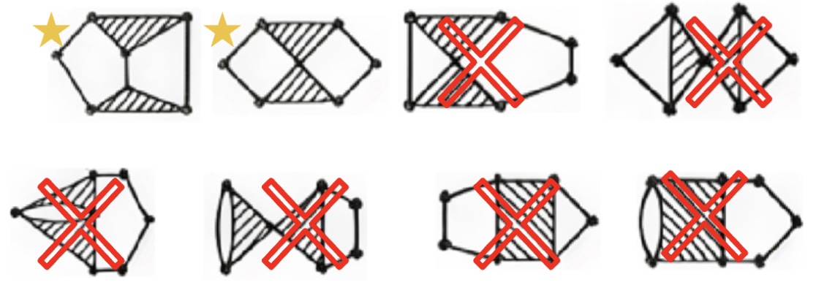
Type Synthesis - 6 Bar

Slide 12
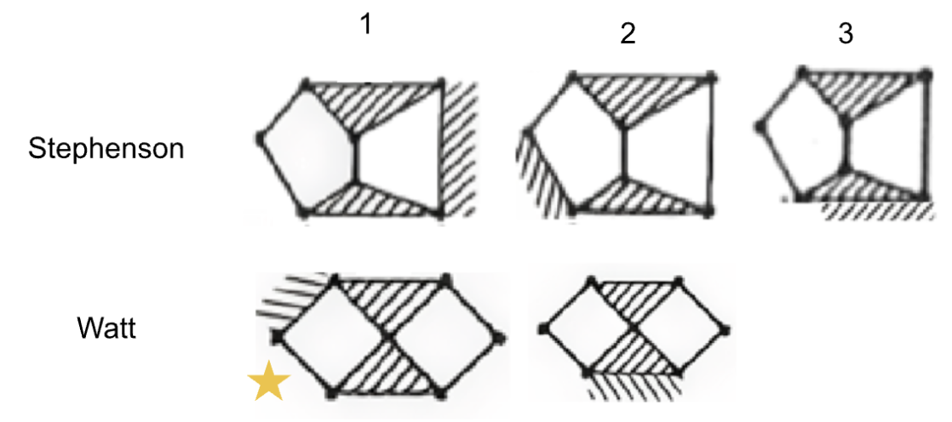
Notes:
Grounding different links within each BKC through kinematic inversion produces the five topological variations: Each inversion was evaluated and the critical differentiator proved to be ground pivot accessibility.
Watt II, Stephenson II, and Stephenson III all require ternary ground links with three ground pivots, which cannot be practically accommodated on the compact greenhouse base structure without extending outside the greenhouse silhouette. Stephenson I, while featuring only two ground pivots, exhibits an extended structure with separated ternary links that results in longer link lengths and potentially unfavorable transmission angles for this application.
For those reasons, we settled on a Watt I configuration which is promising for extended movement with a compact mechanism.

Slide 13
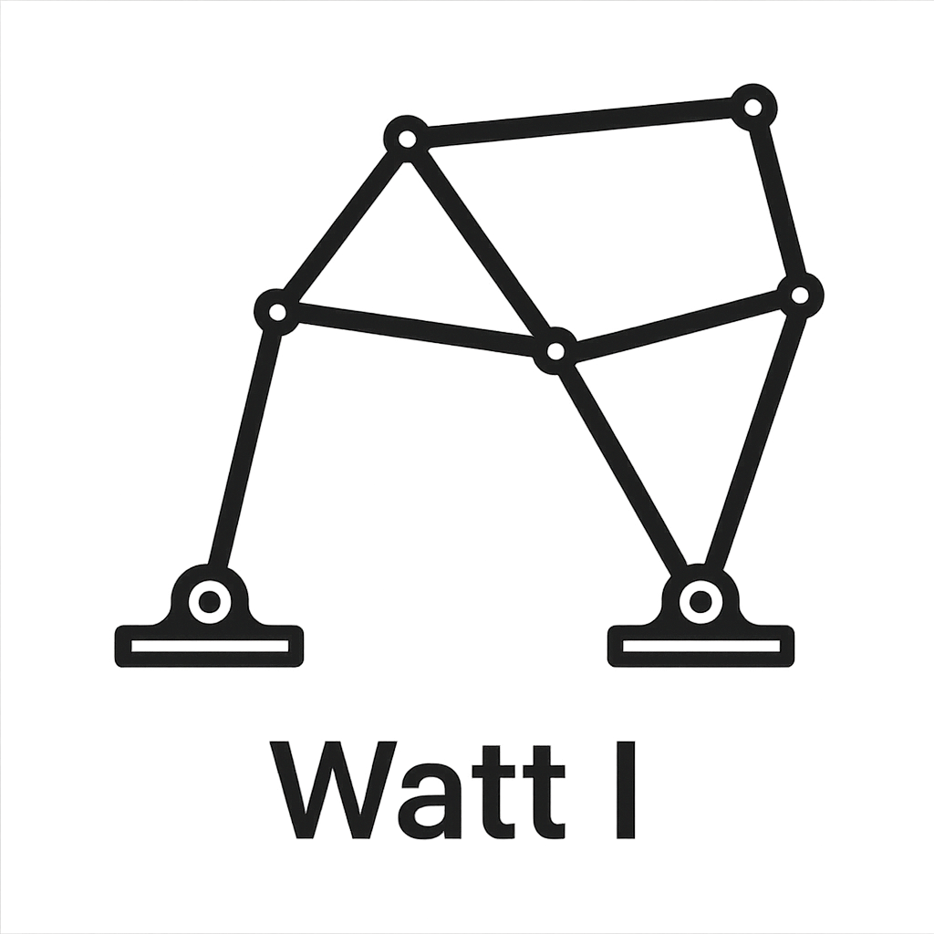

Where We Are Now
Chosen chain to explore: Watt I
Next steps: Develop MatLab program to explore solutions using ground pivot specification.
Notes:
So, our progress has brough us here. We’ve chosen our chain through type synthesis and are beginning to develop a matlab program to explore solutions using ground pivot specifications. Any questions?

Slide 14
Thank you

